Slide 1


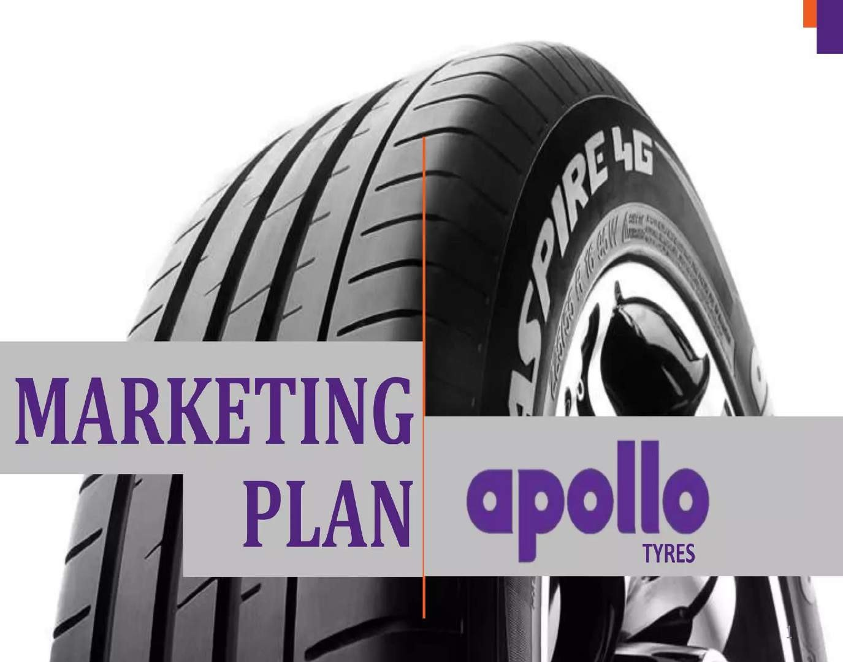




Slide 2


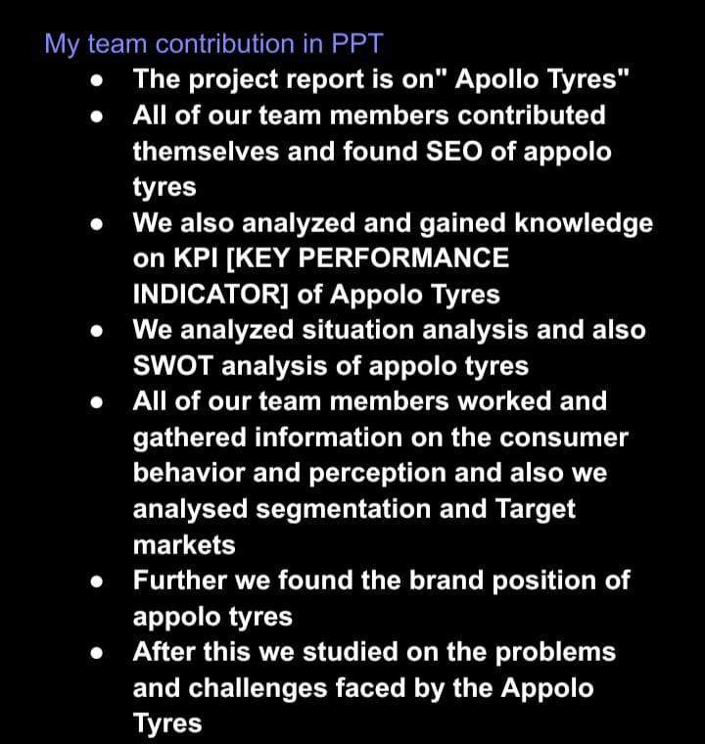

Slide 3

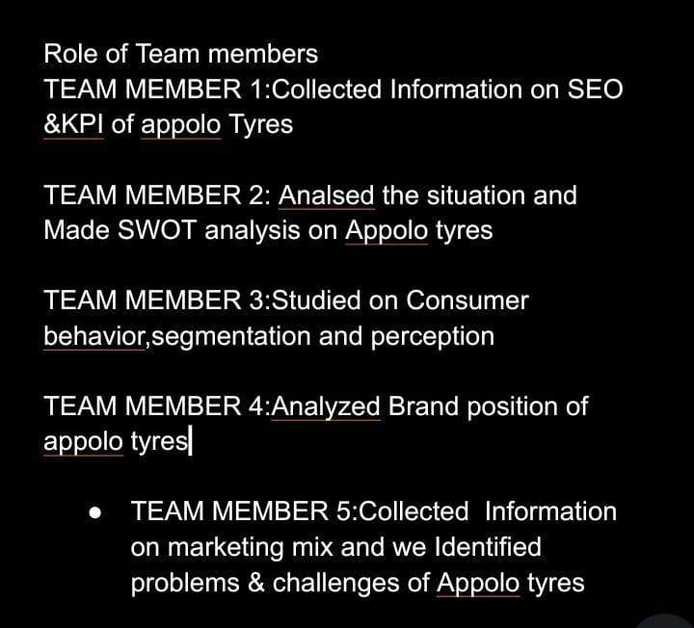

Slide 4

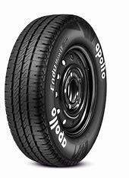
Presented by
Team leader: S Mounika
Team member 1:S Mahanth
Team member 2: S Nagaraju
Team member3 :S Renuka
Team member 4 :S srinivasulu

Slide 5

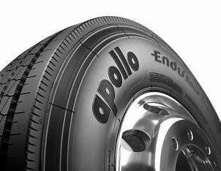
topics
SEO OF APOLLO TYRES
KPI OF APOLLO TYRES
SITUATION ANALYSIS,SWOT
CONSUMER BEHAVIOR,PERCEPTION
SEGMENTATION&TARGET MARKETS
POSITIONING
BRAND POSITIONING
MARKETING MIX
PROBLEMS & CHALLENGES
REFERNCES

Slide 6

 Search Engine Optimization (SEO) is crucial for businesses like Apollo Tyres to enhance their online visibility and reach potential customers. Here are some SEO strategies and recommendations specifically tailored for Apollo Tyres:
SEO
Keyword Research:
Identify relevant keywords and phrases related to Apollo Tyres' products, services, and industry. Tools like Google
Keyword Planner can help in this process.
Focus on long-tail keywords that are specific to tire types, applications, and geographical locations.
On-Page SEO:
Optimize meta titles, meta descriptions, and header tags (H1, H2, etc.) on the website to include target keywords.
Create high-quality, informative, and engaging content that incorporates keywords naturally.
Use keyword-rich alt tags for images and optimize image file names.
Technical SEO:
Ensure the website has a responsive design that works well on both desktop and mobile devices.
Improve page loading speed for better user experience, as page speed is a ranking factor.

Implement HTTPS for a secure website and use structured data markup (schema.org) to enhance search engine listings
Local SEO:
Create and optimize a Google My Business (GMB) listing for each physical location of Apollo Tyres.
Encourage customer reviews and respond to them promptly.
Consistently maintain accurate NAP (Name, Address, Phone Number) information on the website and across online directories.
Content Marketing:
Develop a blog or resource section on the website where you can regularly publish informative articles, guides, and
content related to tires, automotive safety, and maintenance.
Share this content on social media and relevant forums to attract backlinks.
Link Building:
Build high-quality, authoritative backlinks from relevant sources in the automotive and tire industry. Focus on guest posting, outreach, and partnerships.
Disavow or remove toxic backlinks to maintain a healthy link profile.

Slide 7

User Experience (UX):
Prioritize user experience by ensuring your website is easy to navigate, has a clear site structure, and provides valuable information to visitors.
Implement breadcrumbs and a user-friendly navigation menu.
Mobile Optimization:
Optimize the website for mobile users, as Google's algorithm favors mobile- friendly sites. Use responsive design and ensure mobile pages load quickly.
Local Citations:
Ensure Apollo Tyres' business information is consistent across local directories, such as Yelp, Yellow Pages, and industry-specific platforms.
Verify and claim business listings on relevant platforms.
Analytics and Monitoring:
Regularly monitor website performance using tools like Google Analytics and Google Search Console. Analyze traffic, rankings, and user behavior to make data-driven decisions.
Regular Updates:
Keep the website content and information up to date. This includes product listings, prices, and any changes in services or locations.
Social Media:
Maintain an active presence on social media platforms to engage with the audience, share valuable content, and drive traffic to the website.
Remember that SEO is an ongoing process, and it may take some time to see significant results. Regularly review and adapt your SEO strategy to align with changes in search engine algorithms and market dynamics.

Slide 8

Key Performance Indicators (KPIs) for Apollo Tyres, a tire manufacturing company, may include a variety of metrics to measure their performance in different aspects of their business. Here are some potential KPIs for Apollo Tyres:
Revenue: Tracking total revenue and revenue growth over time is a fundamental KPI for
any company, including Apollo Tyres.
Profit Margin: Monitoring the company's profit margins to ensure they are operating efficiently and effectively.
Market Share: Measuring their market share in the tire industry and comparing it to competitors.
Sales Volume: Tracking the number of tires sold, either by type or region, to gauge
market demand and their own sales performance.
Quality Metrics: Monitoring metrics related to tire quality, such as defect rates, warranty claims, and customer complaints, to ensure product quality meets or exceeds industry standards.
Manufacturing Efficiency: Measuring production efficiency, including factors like
production downtime, waste reduction, and process improvements.
Customer Satisfaction: Surveying customers for feedback and satisfaction ratings to ensure that products and services meet their expectations.
Distribution and Logistics: KPIs related to distribution efficiency, including on-time deliveries, order accuracy, and supply chain performance.

Slide 9

Environmental Metrics: Monitoring sustainability KPIs, such as energy consumption, emissions, and waste reduction, to assess their environmental impact and sustainability efforts.
Research and Development: Tracking investments in R&D and innovation, and
assessing the success of new product launches.
Employee Satisfaction: Measuring employee satisfaction and engagement to ensure a motivated and productive workforce.
Safety Records: Keeping track of safety incidents and ensuring a safe working environment for employees.
Financial Health: Assessing the company's financial health through metrics like debt levels, cash flow, and liquidity.
Brand Awareness: Monitoring metrics related to brand recognition, such as social media mentions, brand sentiment, and advertising effectiveness.
Supplier Performance: Evaluating the performance of suppliers in terms of quality,
reliability, and cost-effectiveness.
Compliance Metrics: Ensuring that the company adheres to regulatory and compliance requirements, both in terms of product safety and environmental standards.
These KPIs can provide valuable insights into Apollo Tyres' performance in various areas of their business, allowing them to make data-driven decisions and continually improve their operations. It's essential for Apollo Tyres to choose the KPIs that align with their strategic objectives and industry benchmarks.

Slide 10
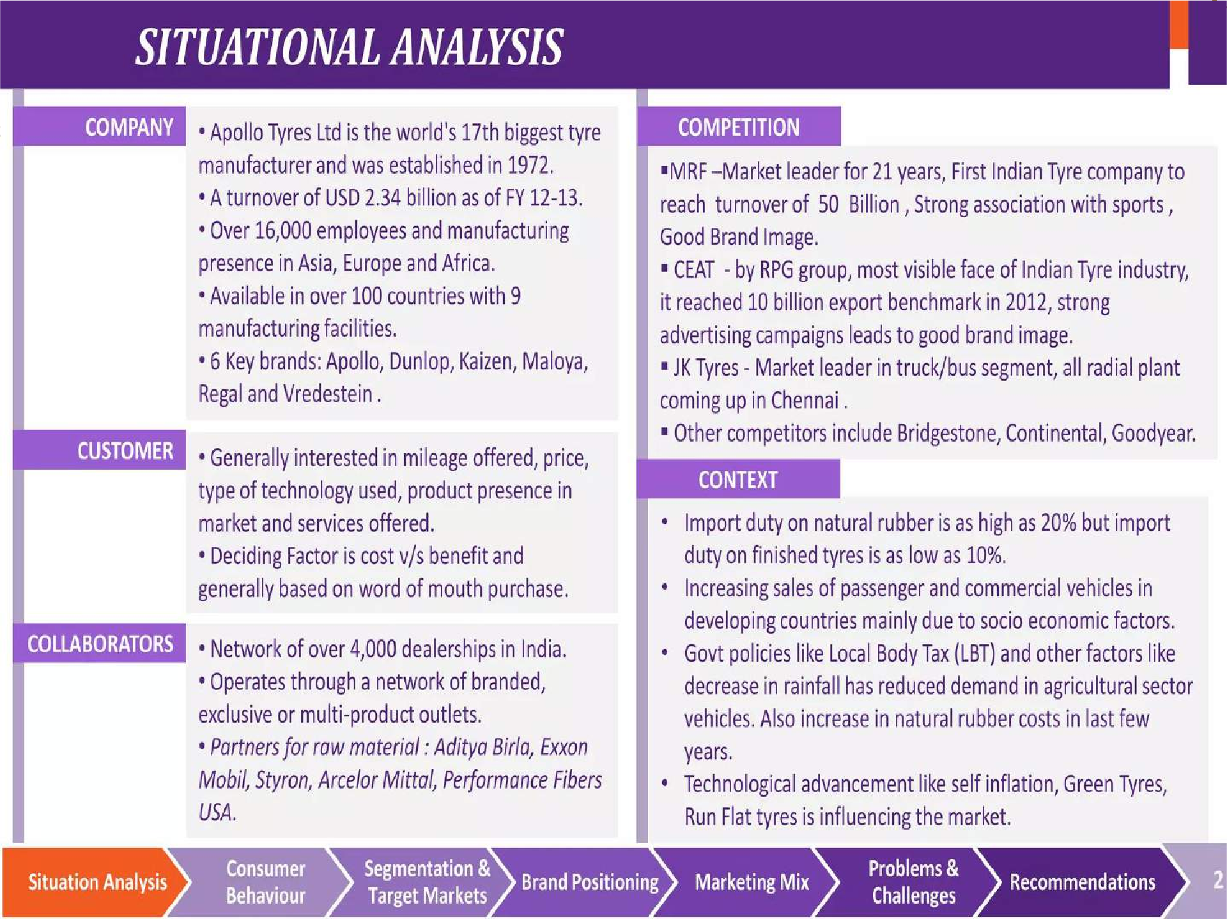


Slide 11
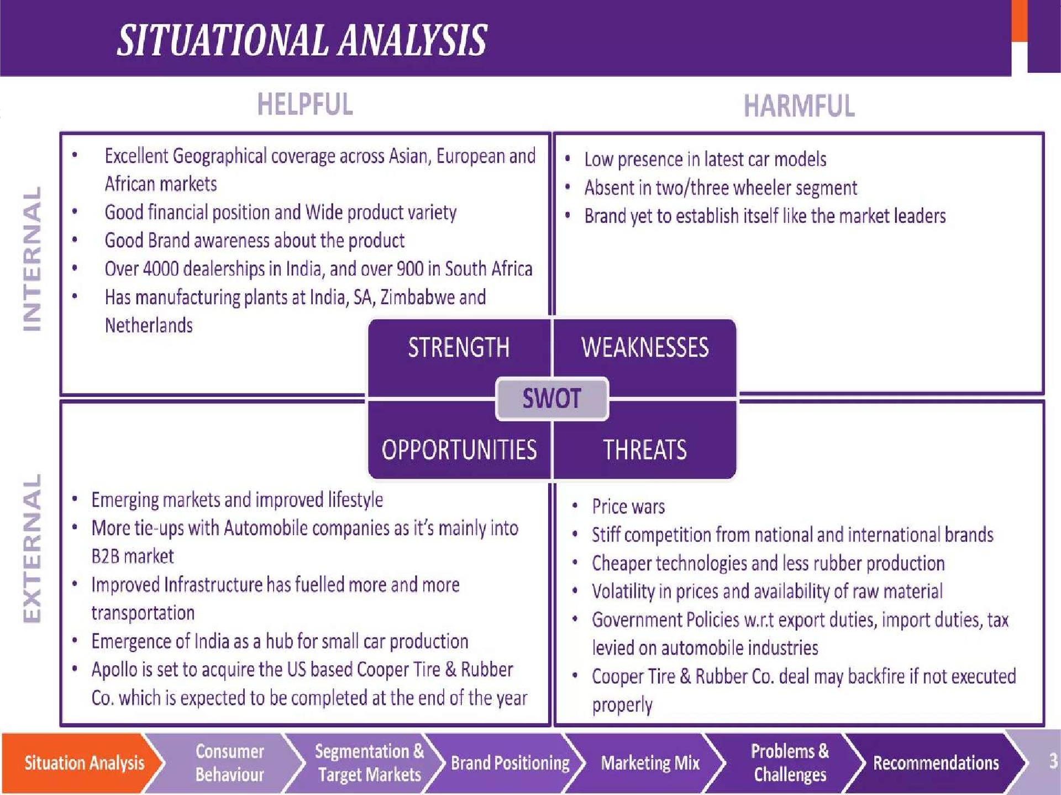


Slide 12
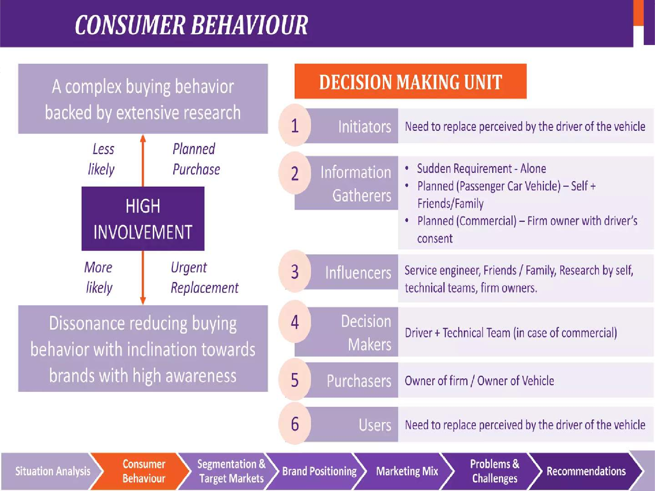


Slide 13
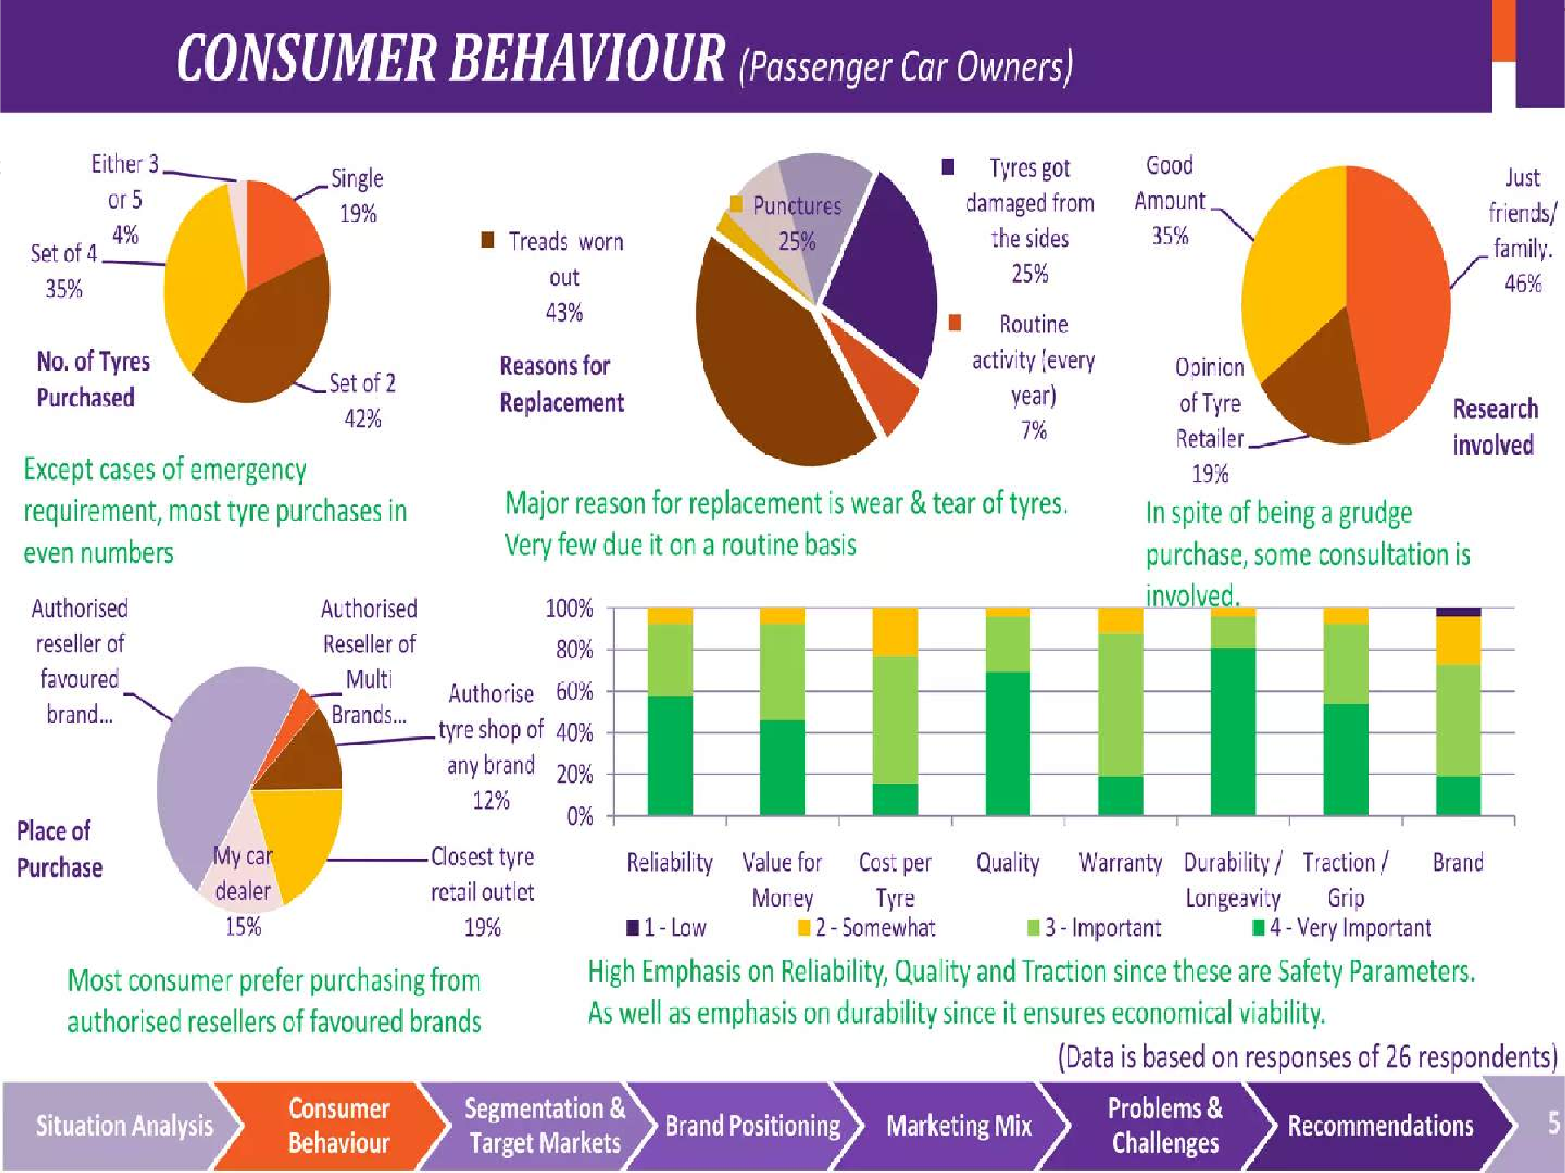


Slide 14
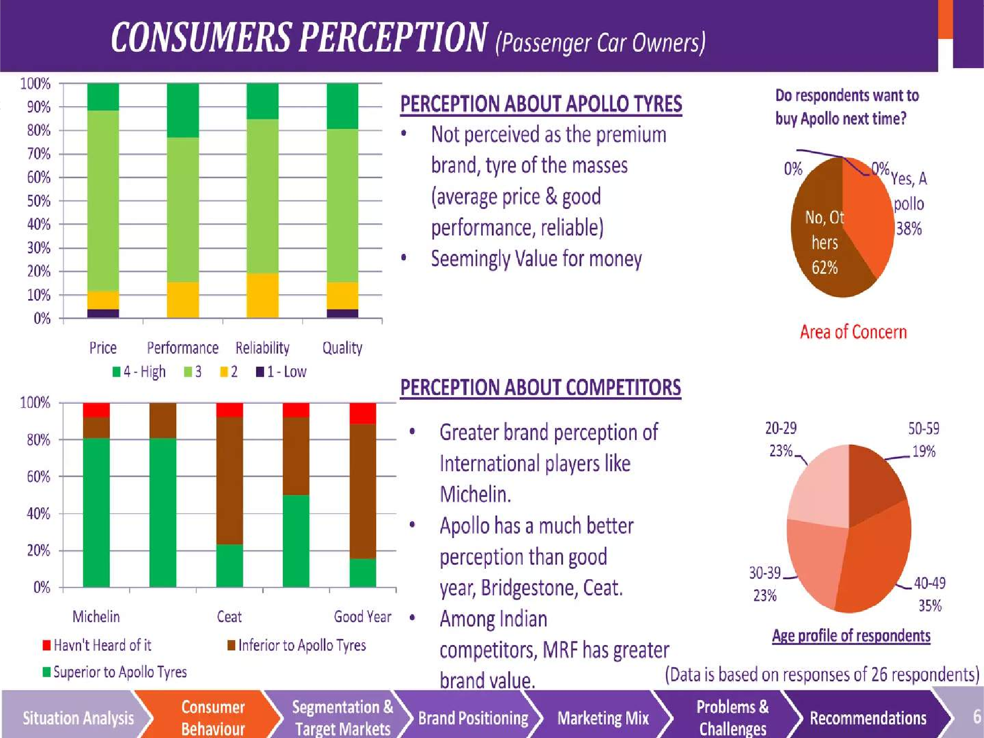


Slide 15
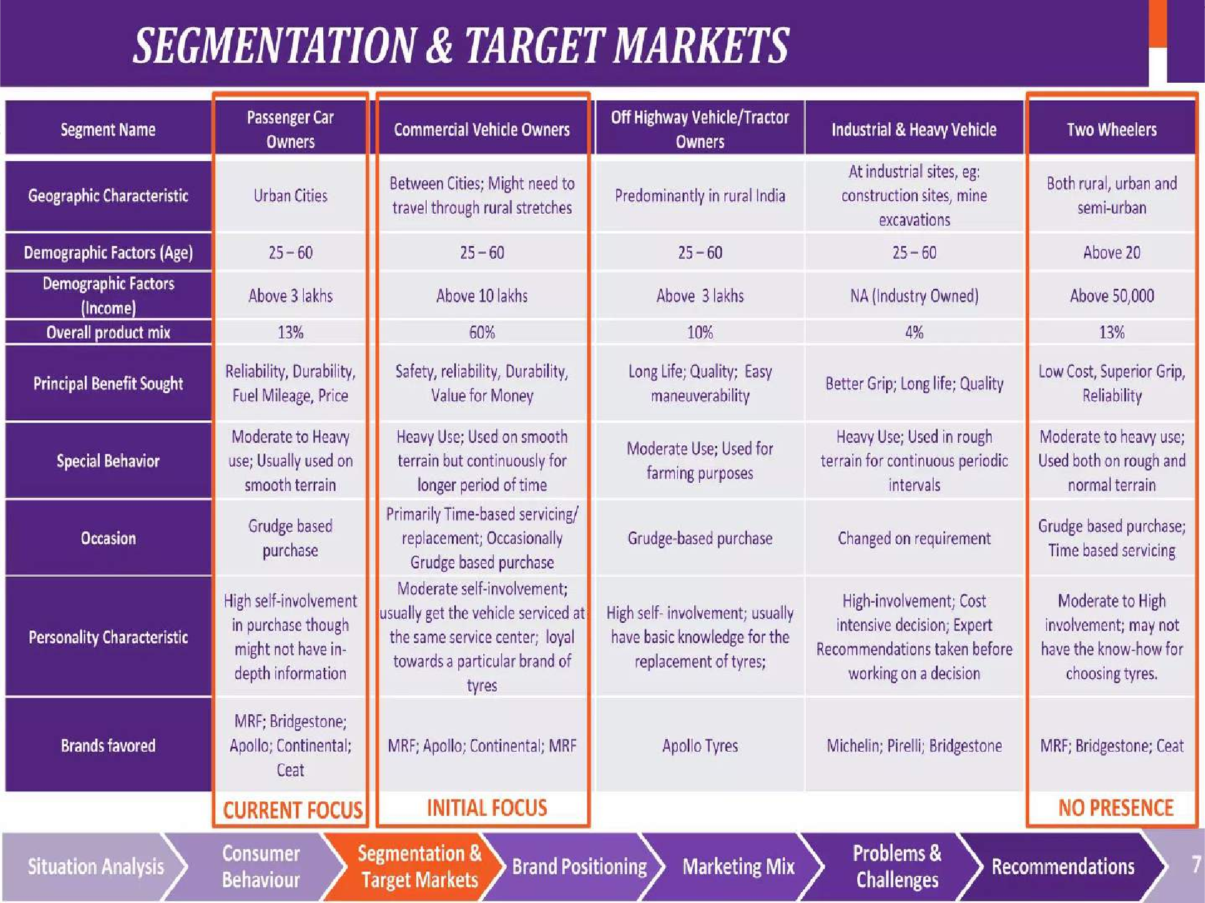


Slide 16
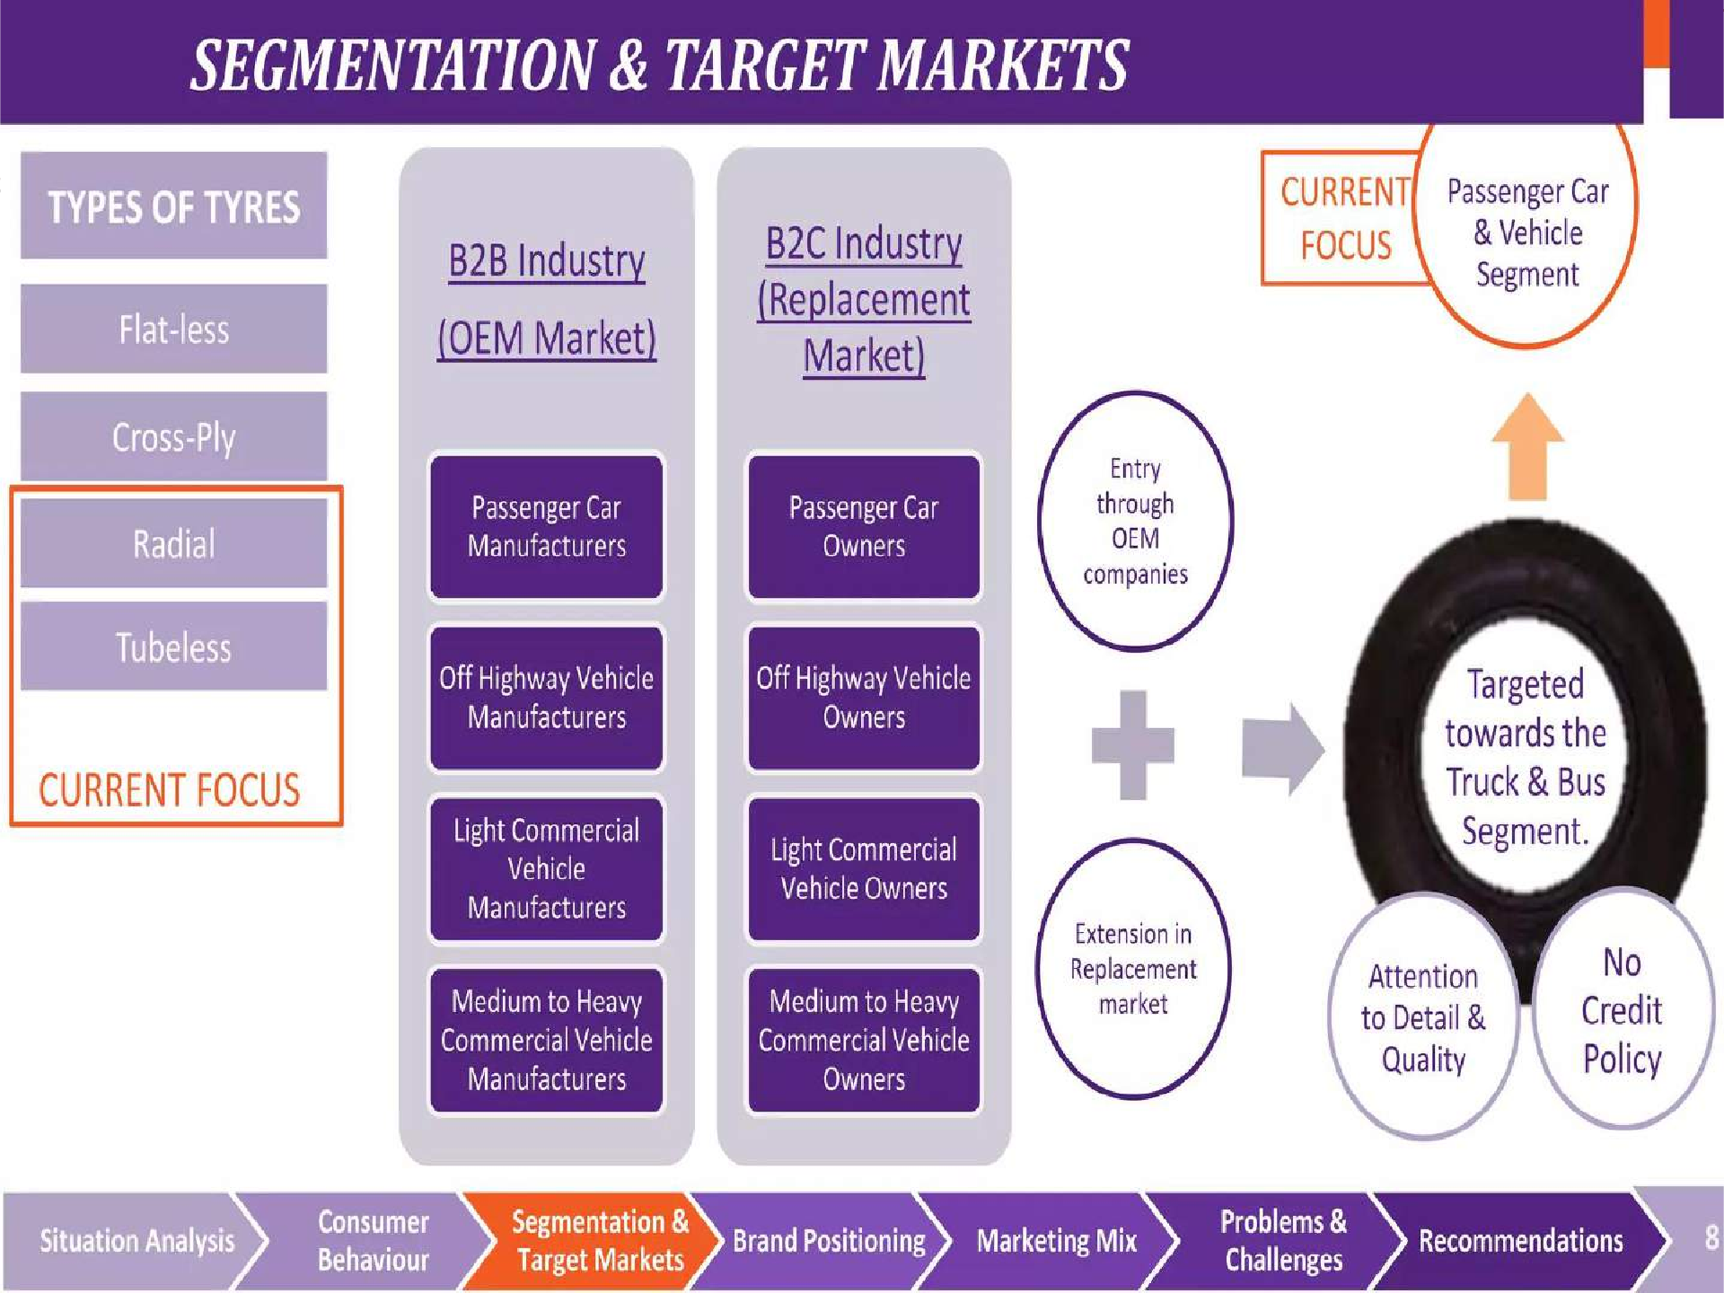


Slide 17
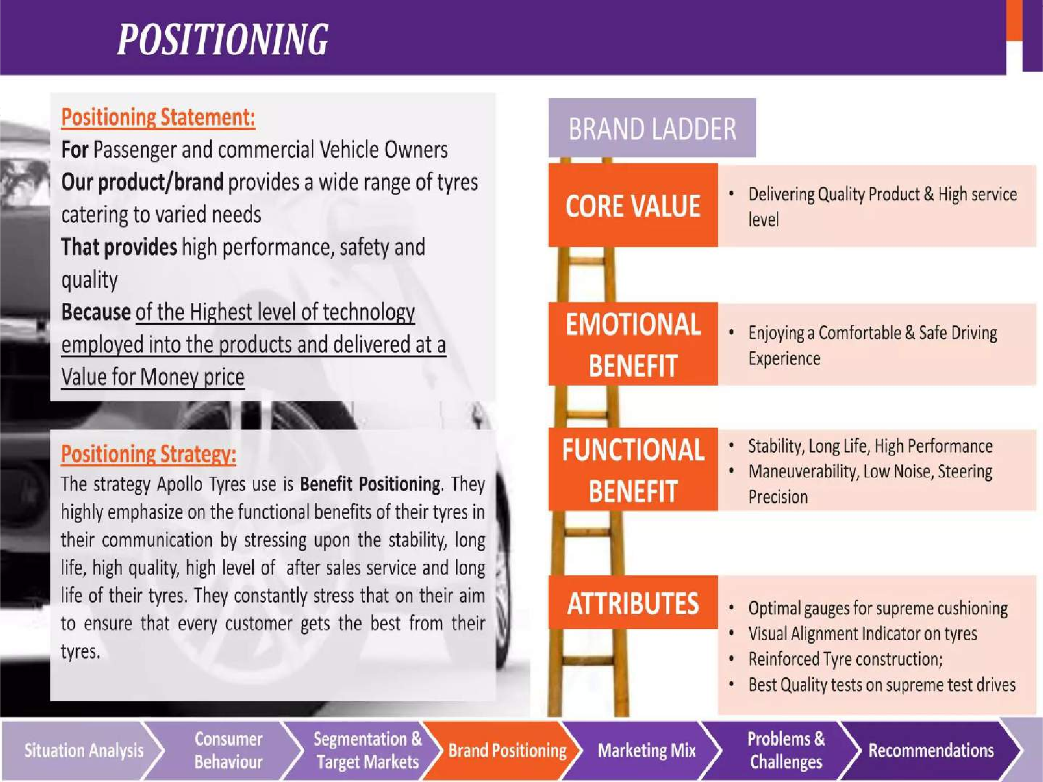


Slide 18
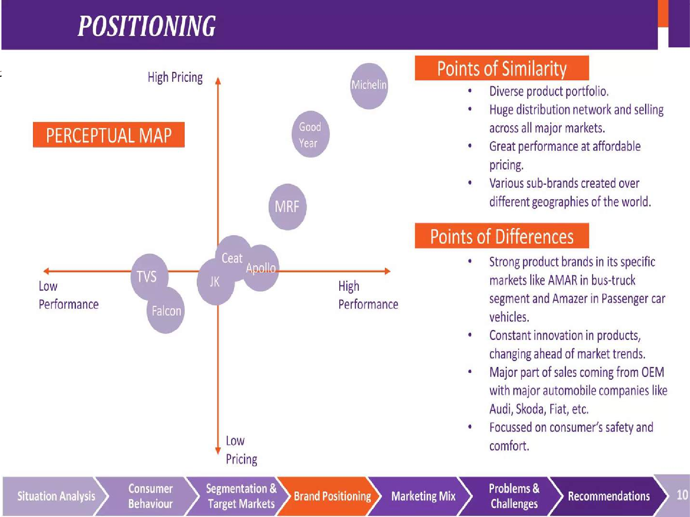


Slide 19
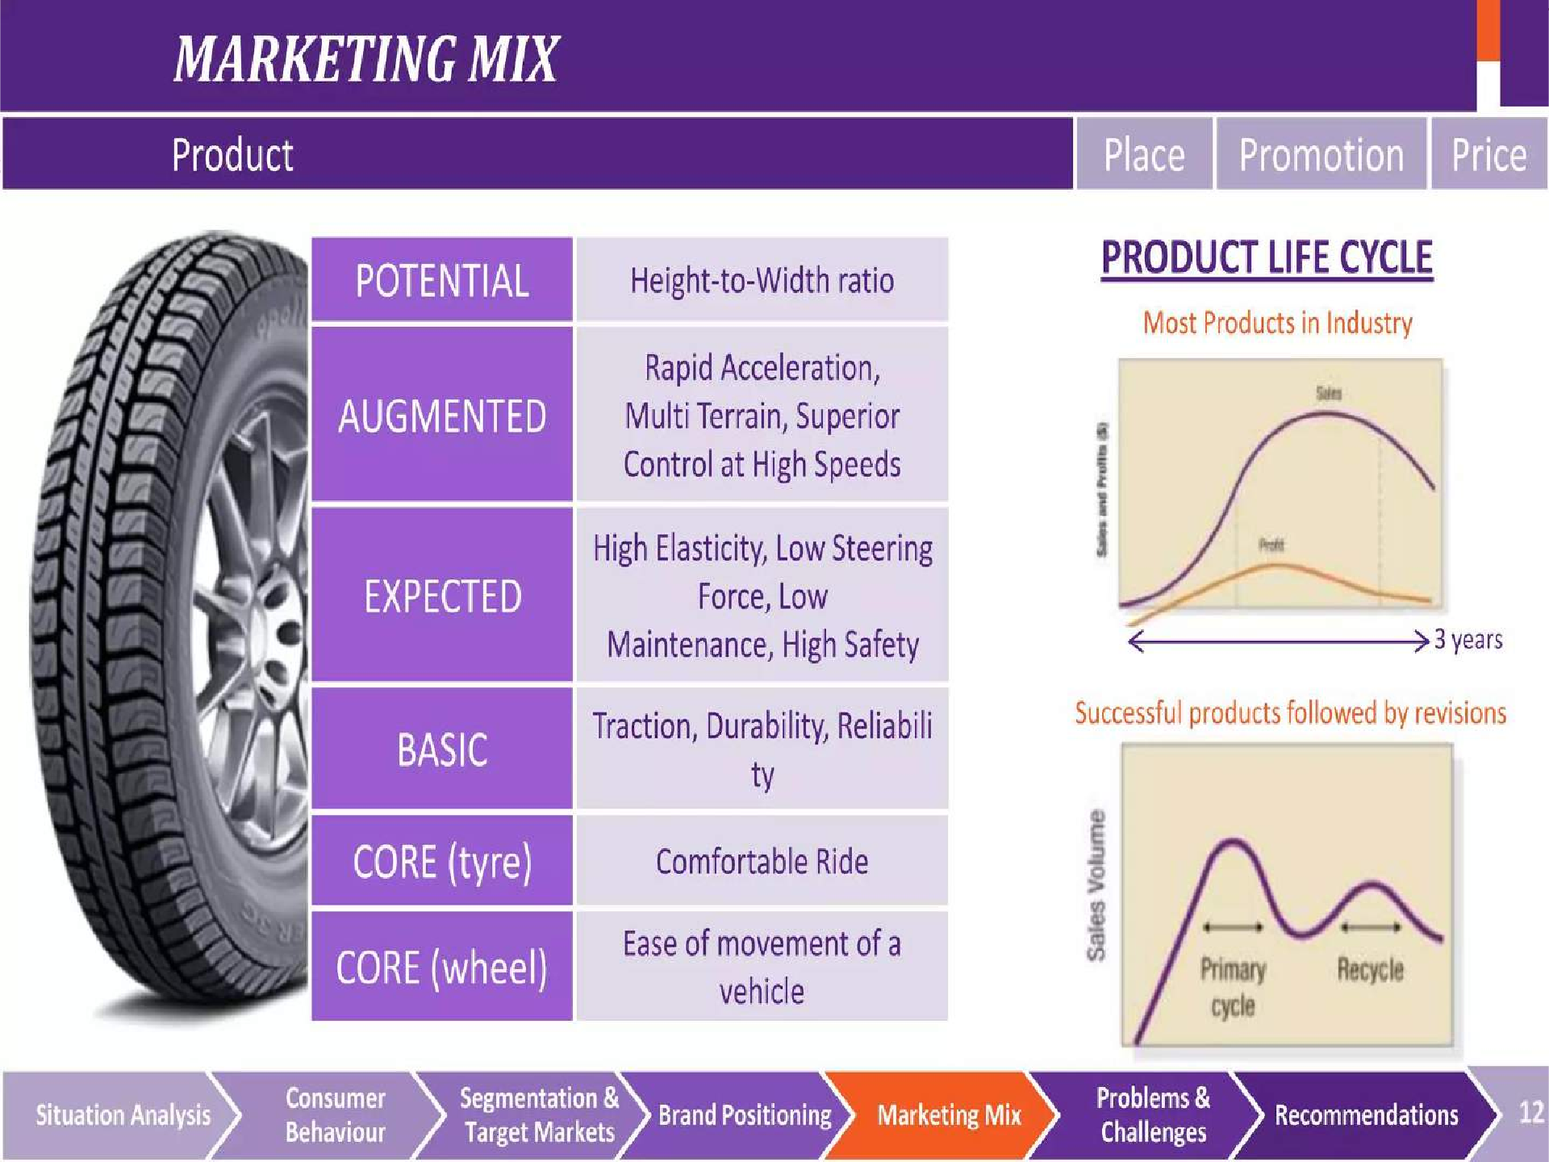


Slide 20
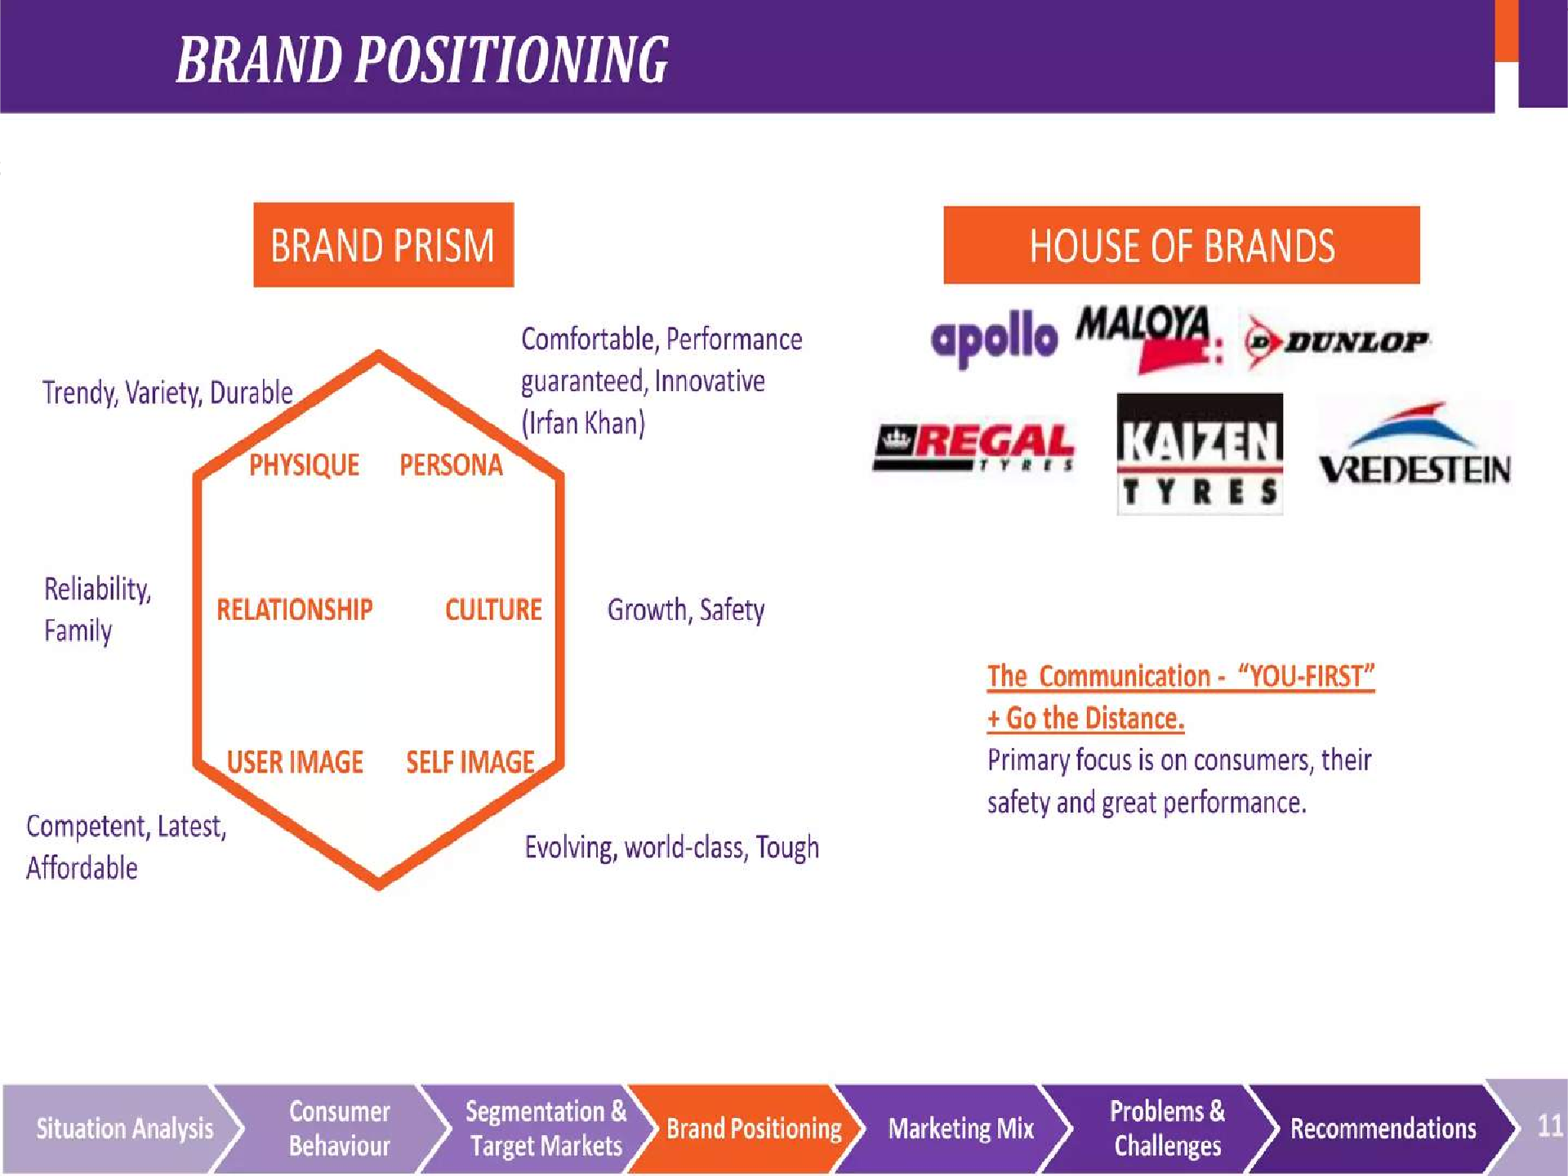


Slide 21
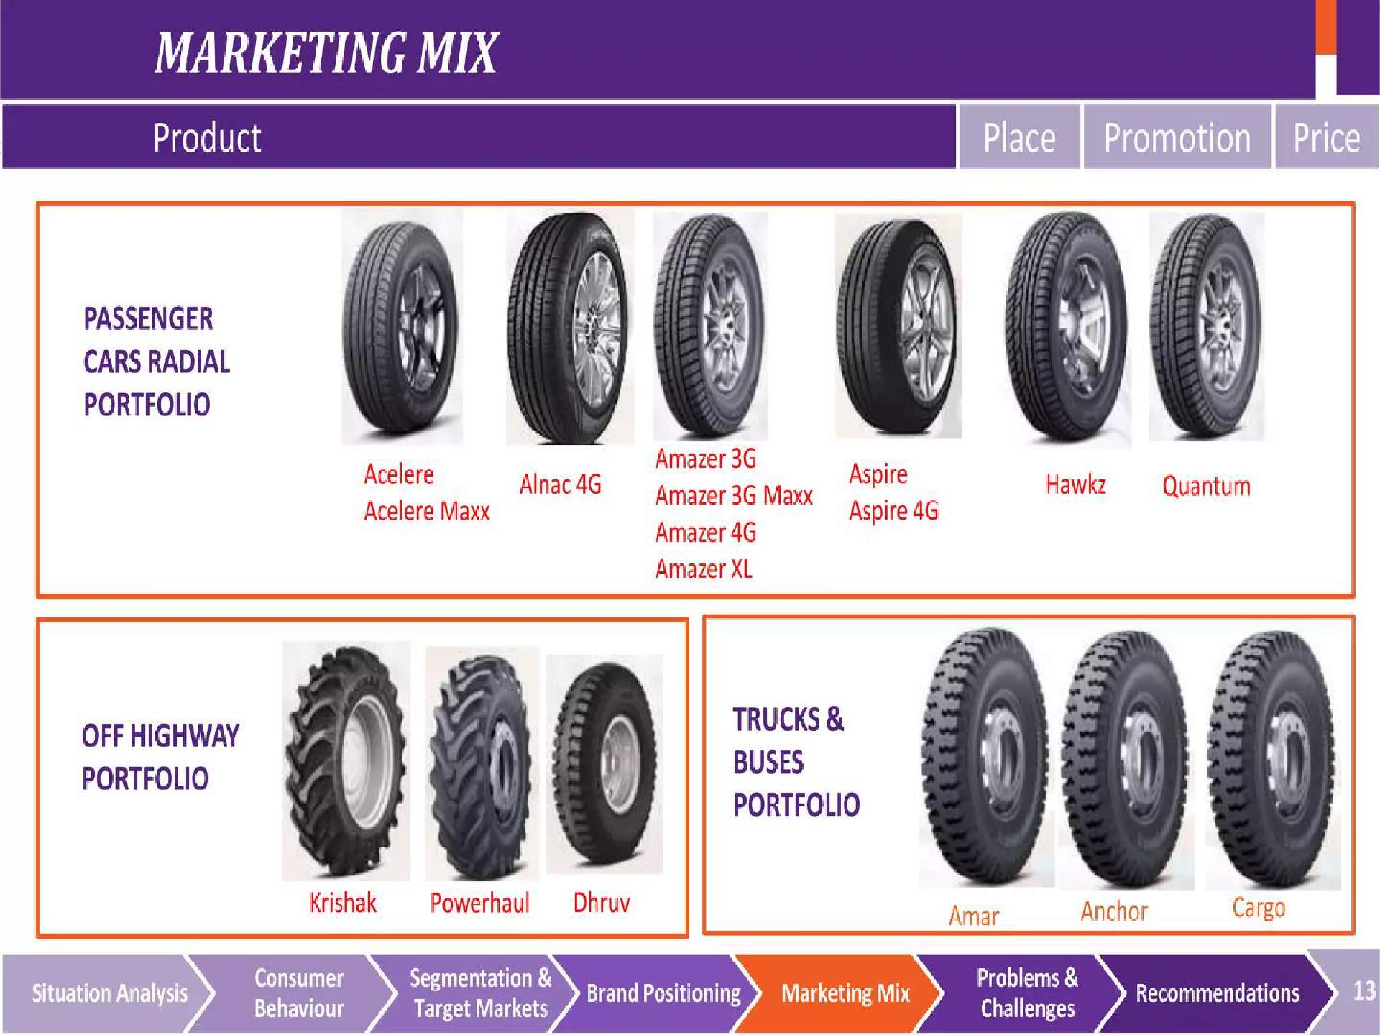


Slide 22
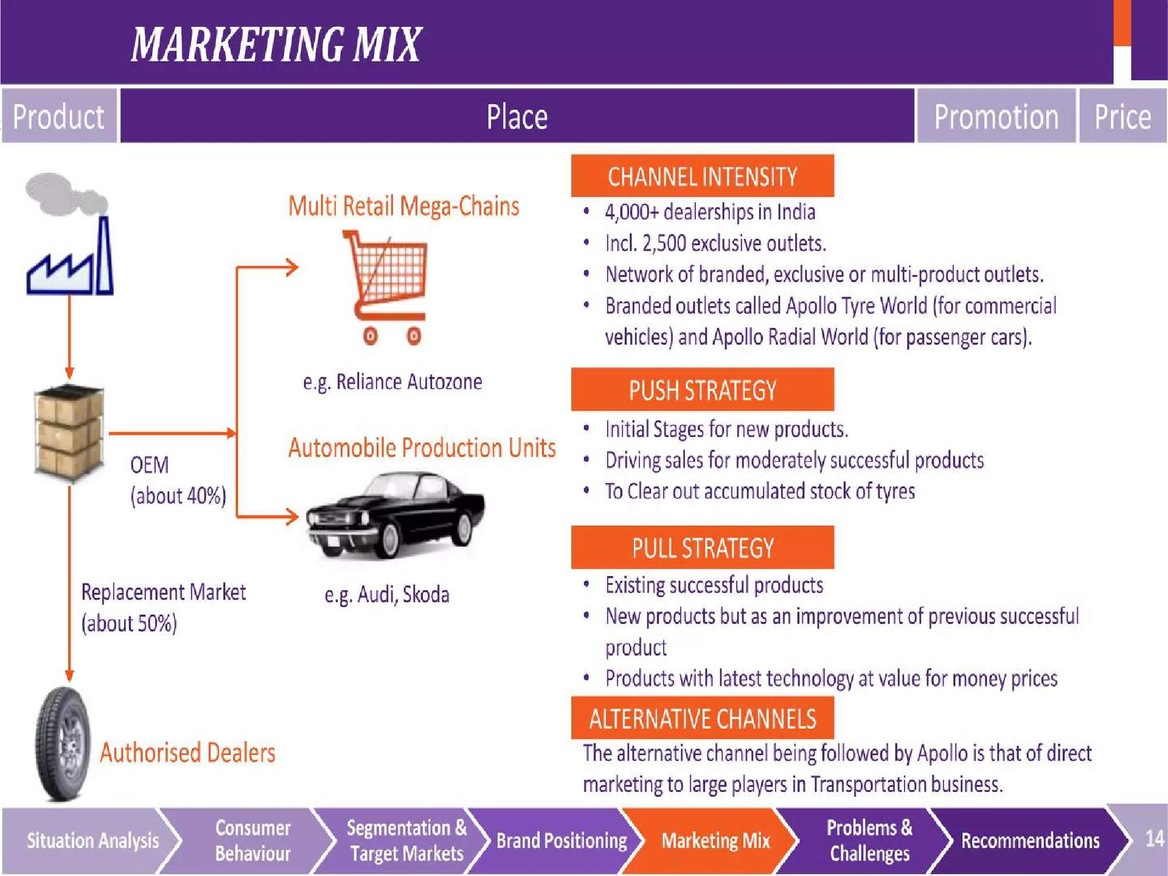


Slide 23
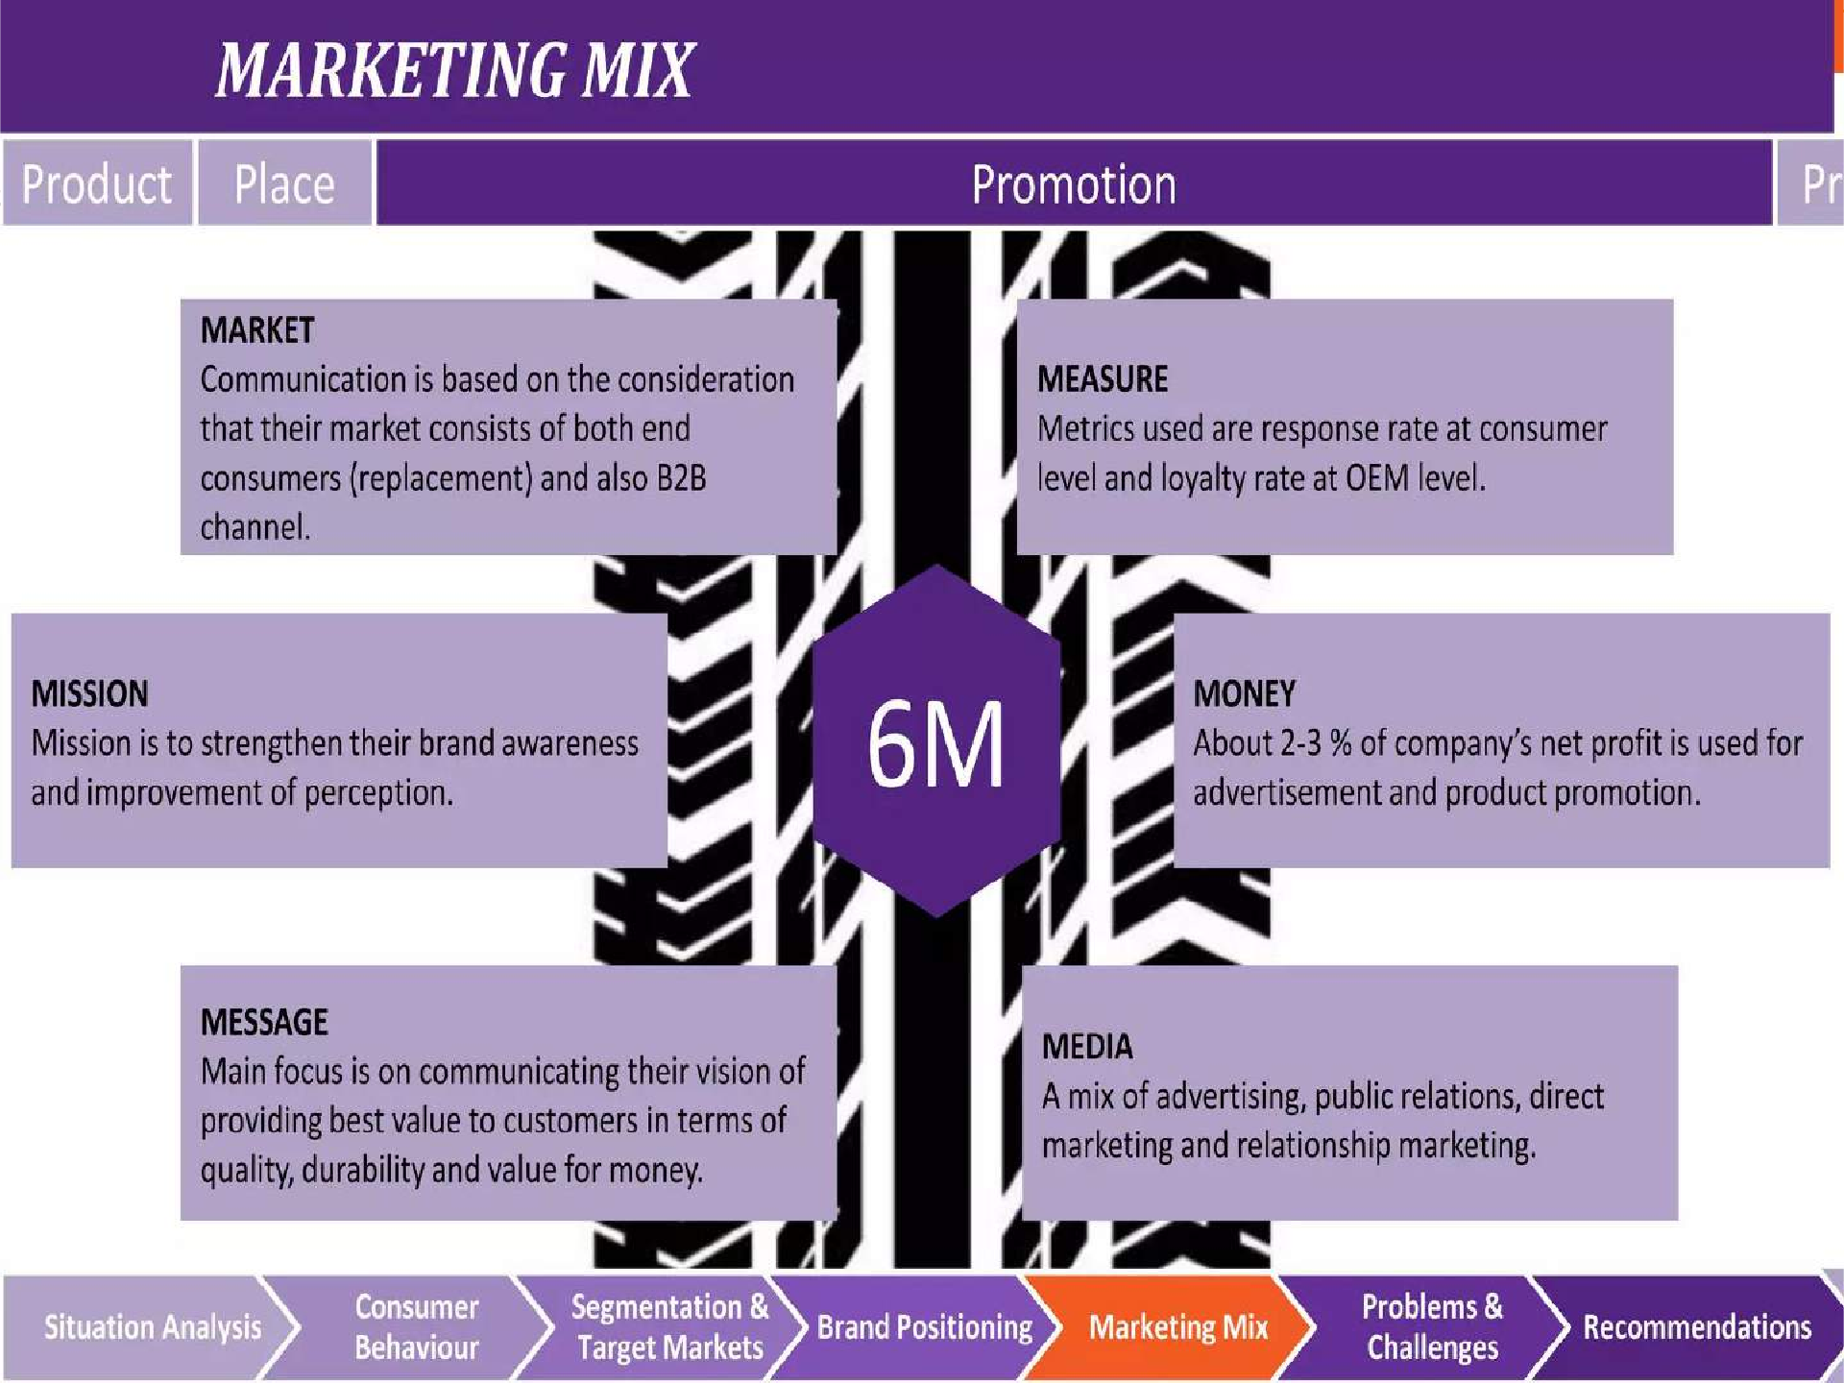


Slide 24
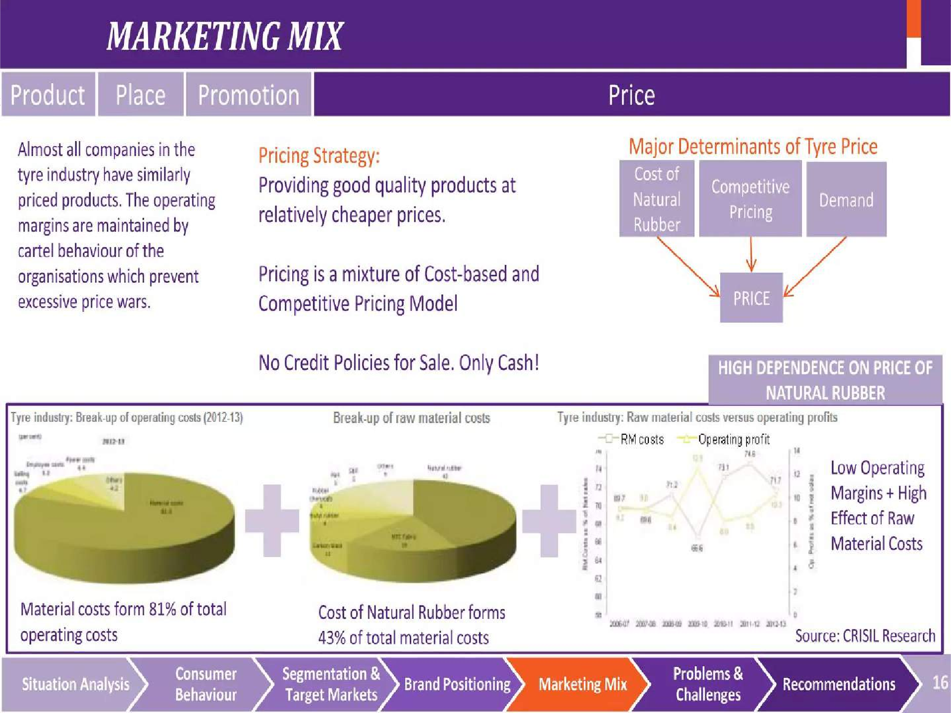


Slide 25
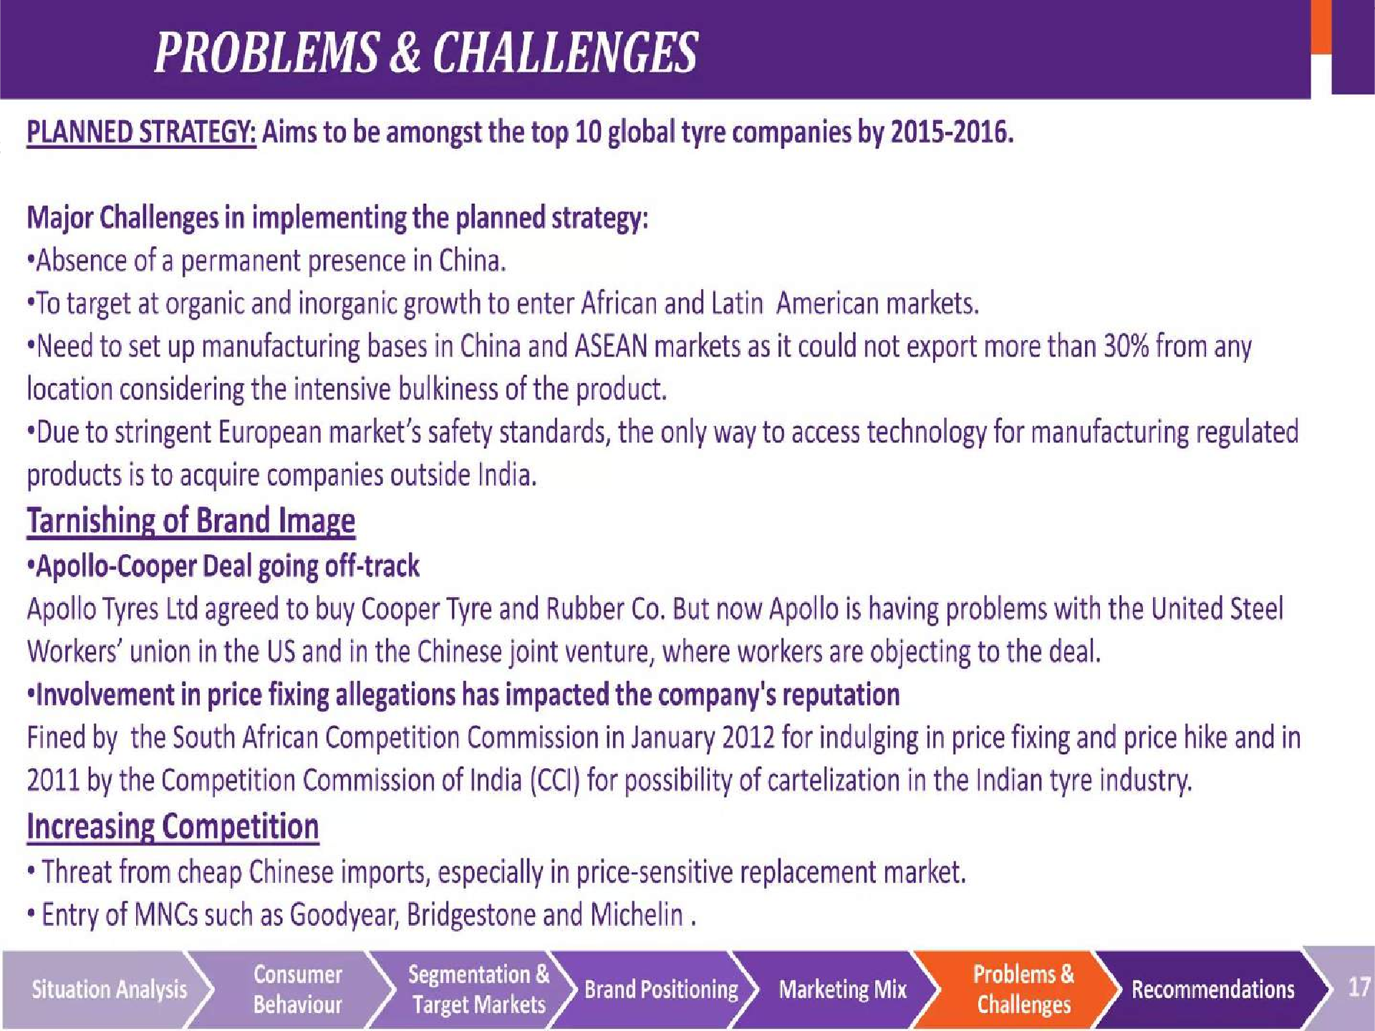


Slide 26
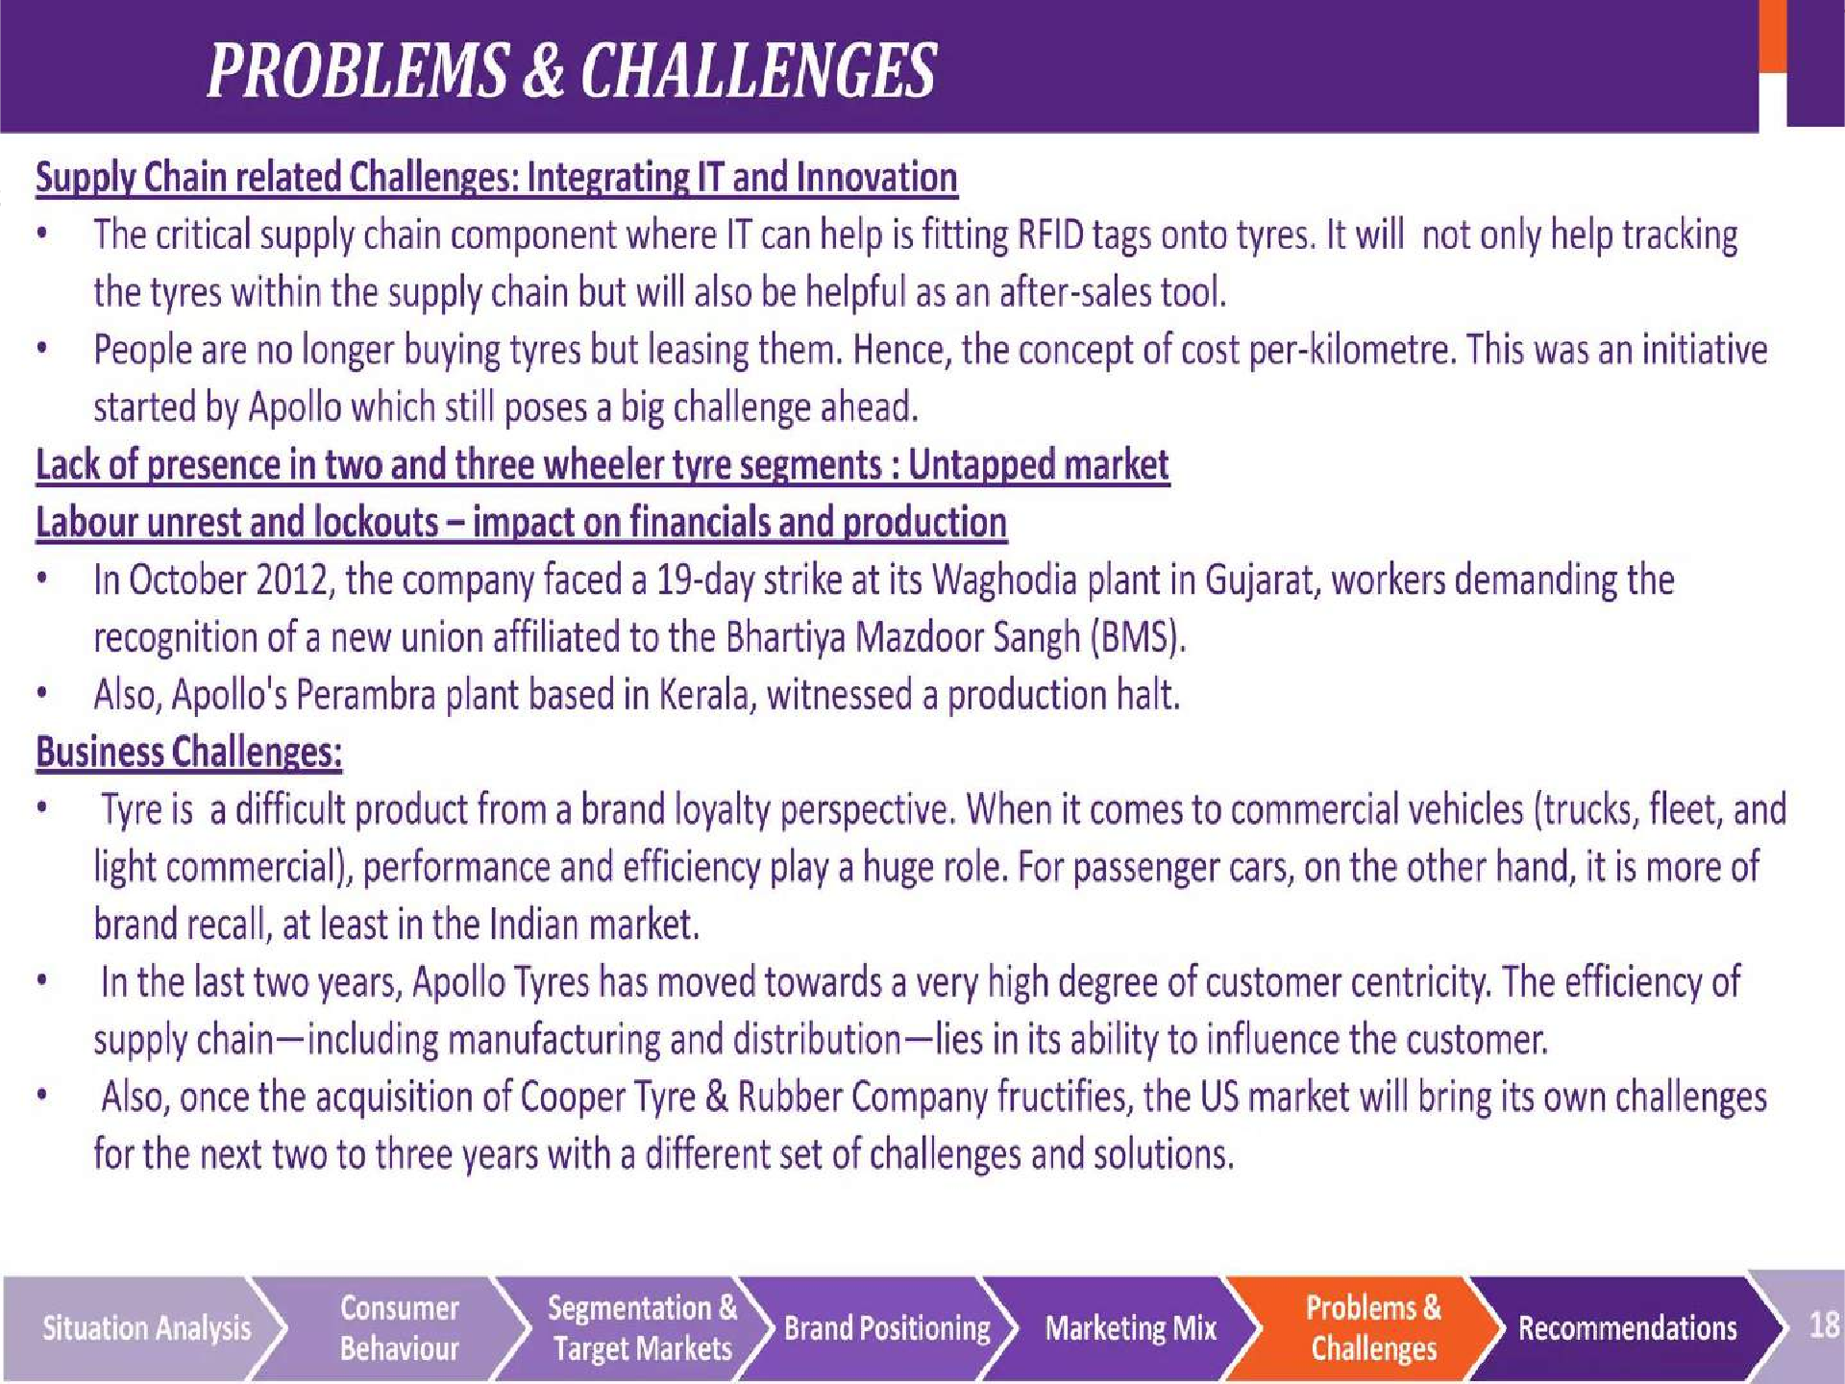


Slide 27
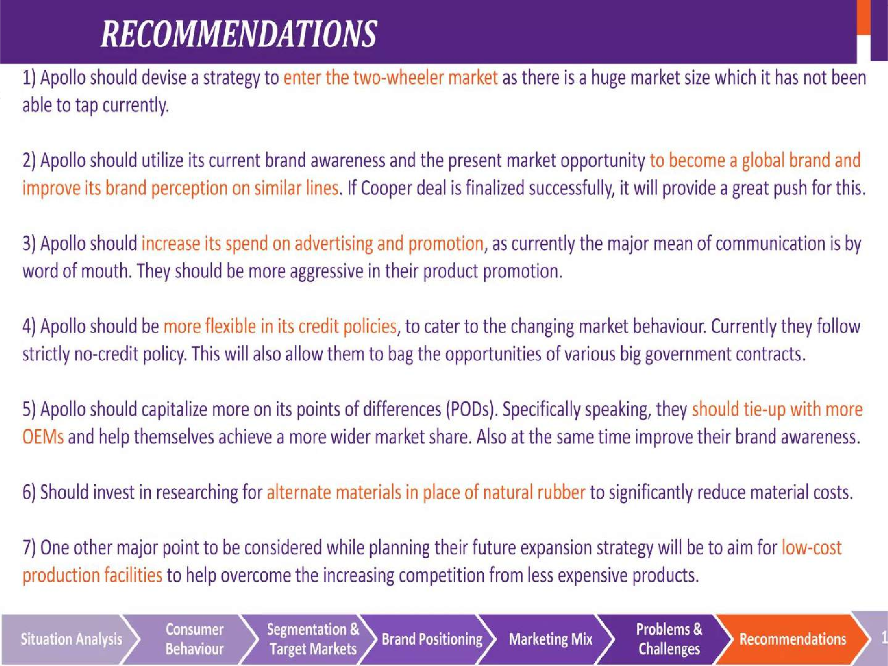


Slide 28
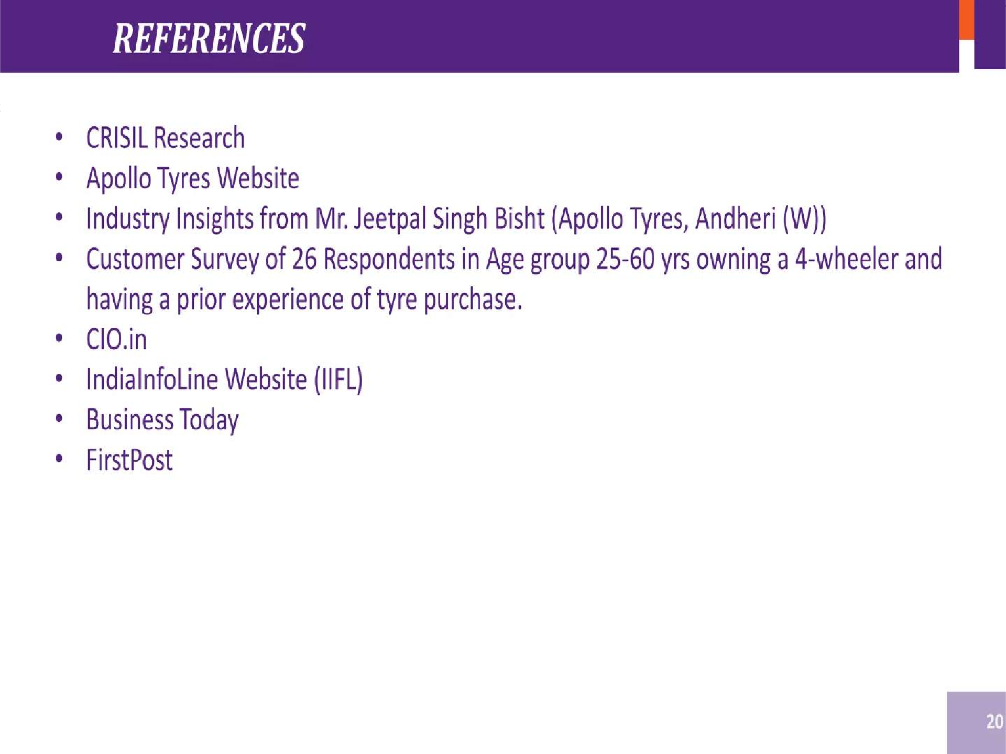


Slide 29
Thank you

